Slide 1

THE ROLE AND ADVANTAGE OF HALAL CONCEPT IN PROMOTING ISLAMIC FINANCE
SELEMAN ABDALLAH – MPM, PMP, CIPM, AMC, BAPPMCD
CEO OF: SPM CONSULTING & HALAL TRAVEL
FOUNDER OF HALAL PROJECT AMBASSADORS

Slide 2

Concept
Halal means permissible to use or engage in, according to Islamic law.
  Permitted by Law (government) and Sharia (Islam)
  Ethical and Safety –Human Kind
  Best and Clean
  Human friendly –Favor the humanity and benefits cause
The term covers and designates not only food and drink but also all matters of daily life.

Slide 3

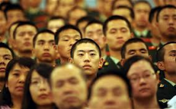

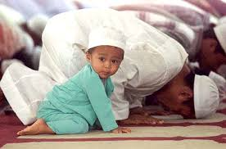

Growing interest in Halal by many Africans
Given that the concept of Halal was designed to be universal
“Oh Mankind, eat what is Halal (lawful) and Thayyib (good, healthy)”

Slide 4
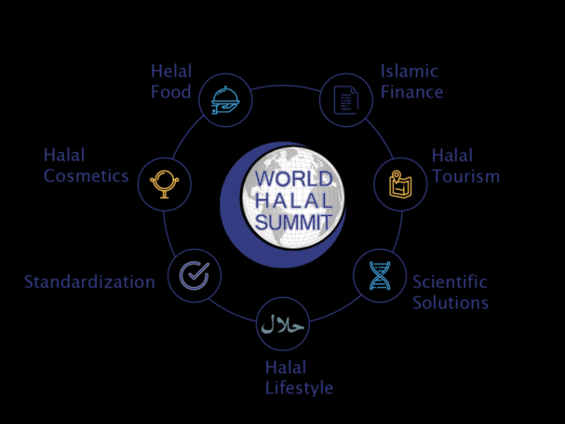

Industries
HALAL
ENTERPRISES
HALAL
AGRO
INDUSTRY
HALAL
FOOD
INGREDIENTS
HALAL
FOOD
PRODUCTS
HALAL
LEATHER
PRODUCTS
FAAB
HALAL
LIFETSTYLE
&
COLLECTIONS
HALAL
COSMETICS
AND
BEAUTY
CARE
HALAL
PHARMACEUTICALS
HALAL
PET AND ANIMAL
FEED

Slide 5
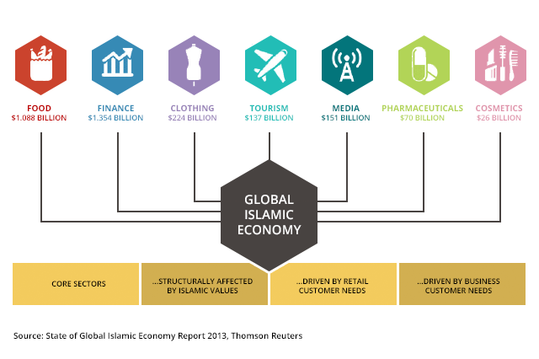

Slide 6
THE HALAL INDUSTRY AND ANY HALAL BUSINESS IS DRIVEN BY THE MUSLIM CONSUMERS LIFESTYLE – FAITH BASED VALUES.
Want services to be Shariah compliant and Thayyib – Pure.
Halal Industry not just confined to food and beverage but tourism, finance, hospitality, pharmaceuticals, cosmetics.
Key Driver is the increase demand for services vs the ability to supply this demand.
Currently the supply is not enough to meet the demand for 1.8 billion people in the world

Slide 7
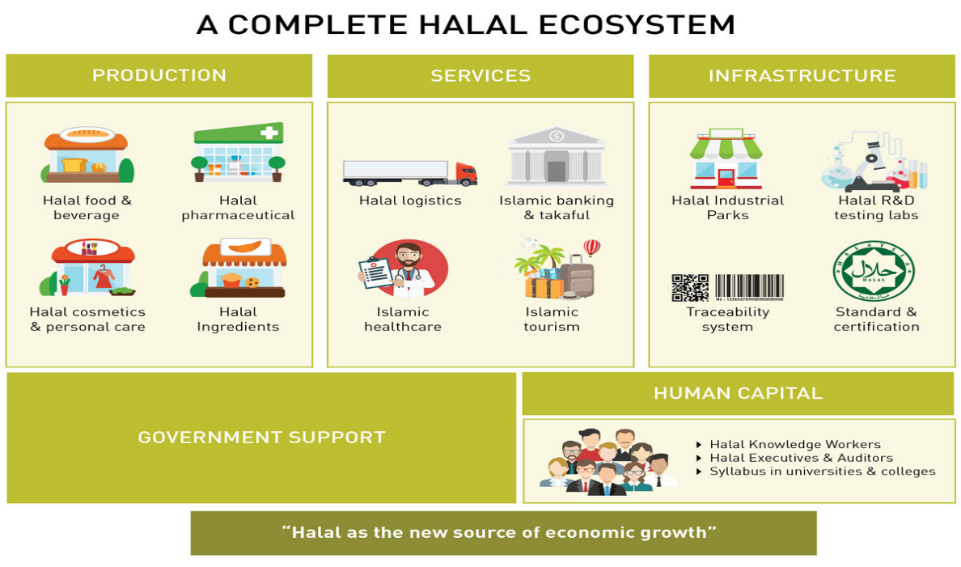








Slide 8
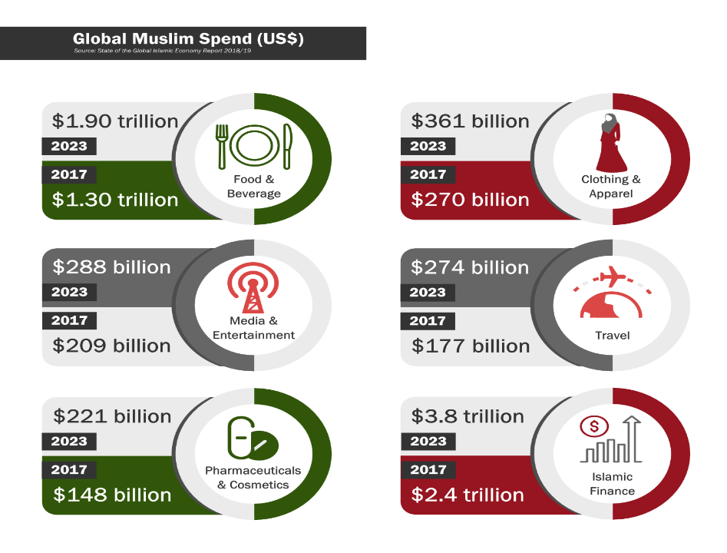

Slide 9

SWOT
Weakness
Lack of qualified expertise in this sector in non-
Muslim countries.
Lack of experienced and skilled workforce.
Lack of investment in this industry from major
investors and institutions.
Lack of public investor knowledge in this sector
outside of the Muslim community.
Lack of coordinated brand marketing.
Lack of proper branded retail outlets.
Lack of general consumer awareness of Halal
products and their health benefits.
Strength
Halal is an absolute requirement in the Islamic community -1.6 billion population.
Well developed market in the Muslim sector.
Well developed products – Food and consumer goods.
Well defined market segment.
Captive consumer audience.
A large proportion of the Muslim community have a high spending capacity.
Well regulated sector for quality as all products are certified or accredited.
Threats
Geo –political issues.
Religious issues
Misinterpretation of Islamic laws.
Breaking Islamic principles.
Anti commercial backlash.
Competition from major brands.
Competition from major super markets with their own brand of Halal e.g. Tesco etc.
Environmental issues giving rise to price wars.
Inflationary pressures in the future.
Opportunities
Consumer size - 1.6 billion Muslims.
Market size – US $2.1 trillion.
Diversified Industry Groups.
Fragmented market segment.
Need for a global brand.
50% of population below the age of 35.
Reaching non-Muslim population who are already Organic food conscious.
Entering into new food sectors like Fast Food e.g. Halal Pizzas etc.

Slide 10
Global Halal industry
The global halal industry is estimated to be worth around USD2.3 trillion (excluding Islamic finance).
Growing at an estimated annual rate of 20%, the industry is valued at about USD560 billion a year.
Thus, making it one of the fastest growing consumer segments in the world. The global halal market of 1.8 billion Muslims is no longer confined to food and food related products.

Slide 11
Global Halal industry
The halal industry has now expanded beyond the food sector to include pharmaceuticals, cosmetics, health products, toiletries and medical devices as well as service sector components such as logistics, marketing, print and electronic media, packaging, branding, and financing.
(Fleishman Hillard Majlis 2011, Dar, Azmi et al. 2013)

Slide 12
In recent years, with the increase in the number of affluent Muslims, the halal industry has expanded further into lifestyle offerings including halal travel and hospitality services as well as fashion.
This development has been triggered by the change in the mind set of Muslim consumers as well as ethical consumer trends worldwide.

Slide 13
GROWING OF HALAL INDUSTRY OUT OF ISLAM
In recent years, with the increase in the number of affluent Muslims, the halal industry has expanded further into lifestyle offerings including halal travel and hospitality services as well as fashion.
This development has been triggered by the change in the mind set of Muslim consumers as well as ethical consumer trends worldwide.
The halal market is non-exclusive to Muslims, and has gained increasing acceptance among non-Muslim consumers who associate halal with ethical consumerism.
As such, the values promoted by halal - social responsibility, stewardship of the earth, economic and social justice, animal welfare and ethical investment - have gathered interest beyond its religious compliance.

Slide 14
No longer a mere religious obligation or observance for Muslims, halal (which means “lawful” or “allowable”) has become a powerful market force, becoming increasingly a world-wide market phenomenon for both Muslims and non-Muslims alike.
The appendage of “Halal” to a product is not just a guarantee that the product is permitted for Muslims, but it has also become a global symbol for quality assurance and lifestyle choice.

Slide 15
Based on a report from the United Nations, Islam is the 2nd largest religion after Christianity. UN statistics recorded yearly growth of Muslims at aroud 6.4% compared to 1.46% for Christianity. According to the same statistics, 1 in 5 persons in this world is a Muslim by birth or geography.

Slide 16
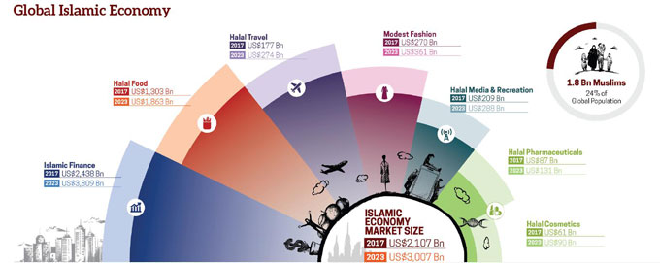
Figures show that the global halal market size is expected to reach US$9.71 trillion by 2025, with countries such as Malaysia, set to lead the pack over the coming years.
According to the ‘State of the Global Islamic Economy Report 2018/19’ by Thomson Reuters, in collaboration with DinarStandard, with 1.8 billion Muslims, and Muslim spend estimated at US$2.1 trillion in 2017, the Islamic economy continues its steady growth.

Slide 17
Sub-Saharan Africa make up 15% of Muslims worldwide and is projected to grow by nearly 60% in the next two decades.

Slide 18
Much has already been written about Islamic finance and the Halal opportunity, and in more depth than we cover.
Our purpose in this presentation is to flag up the development of the opportunity, highlight where the greatest potential lies and analyze the communications and reputation issues that companies and industry stakeholders need to be aware of.

Slide 19
Principally, these sectors should not be deemed separately as they are under the same umbrella of Shariah.
The collaboration of the industry can lead to harmonious system that can support each other.
In this case, the Islamic financial system through Islamic banking and capital market instruments will channel their long term funding to other Halal industry

Slide 20
Islamic banking and finance industry should be channeled to Halal industry to ensure the comprehensiveness of the compliance.
  Financial Compliance
  Loans and Capital
  Investment Model
  Saving and Transactions
  Access to Muslims

Slide 21
Agenda on Halal Integration
Halal consumption and businesses are not just about halal ingredients and production process.
It must cater all aspects of Halal and Haram in Islam. Islam should be practiced as the whole rather than taking only some parts of it.
In that case, the halal goods should not be looked from the production part only but should be monitored as a whole process from getting the raw material until they are received by the consumers and their transaction and financial channeling ways.

Slide 22
Quran
Then is it only a part of the Book that you believe in, and do you reject the rest? but what is the reward for those among you who behave like This but disgrace In This life?- and on the Day of Judgment They shall be consigned to the Most grievous penalty. for Allah is not unmindful of what ye do. (Al-Baqarah: 85)

Slide 23
Ahmad (2008) in his analysis of Shariah literature linked this situation with pillars of contracts (contractors, recognized subject matters and, offer and acceptance), and elements that lead to the bound contract in the Islamic Transaction Law (Fiqh Muamalat).
Recognized subjects here related to products and prices, and both must halal.

Slide 24
The industry however is criticized as does not unite and connect the halal industry with Islamic financing.
The inconsistency has been highlighted by the World Halal Forum 2011 Director who stressed on the need to connect the two sectors – halal businesses and halal financing (Evans, 2010).

Slide 25
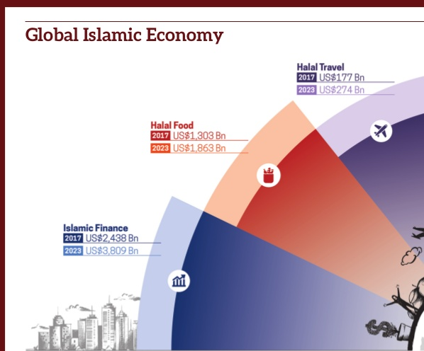

Slide 26
This presentation attempts to expand the idea of bridging the gap between Islamic financing and halal industry to achieve the comprehensive halal compliance practices in Tanzania and our other countries.

Slide 27
Under the sharia law on transactions, there are various types of contracts, from contract of sales and purchases (e.g. murabahah), contract of usufructs such as leasing (ijarah), contract of sharecropping (muzara’ah), to partnerships and equity participation (musharakah and mudarabah).
Islamic financial institutions are permitted to adopt all these types of contract.
Under these contracts, the law prohibits the collection and payment of interest, the avoidance of economic activities involving speculation or ‘gharar’ and the investment in unlawful activities

Slide 28
Halal Close Integration with Finance
Halal consumption and businesses are not just about halal ingredients and production process. It must cater all aspects of Halal and Haram in Islam.
Islam way should be practiced as the whole rather than taking only some parts of it.
In that case, the halal goods should not be looked from the production part only but should be monitored as a whole process from getting the raw material until they are received by the consumers.

Slide 29
In order to ensure that the Halal industry continues unhindered with its progress and realizes it potential and promise, two major areas need to be addressed as soon as possible.
One is the very limited relationship that it enjoys at the moment with Islamic finance sector and
Secondly, the role it can play in development of the SME sector.
Halal industry and Islamic Finance markets are two major Shari’ah-compliant industries that are both said to be growing at around 15-20 percent per annum and as pointed out earlier have a combined value in excess of a trillion Euros.

Slide 30
One would expect there to be extensive cooperation between them, due to adherence to similar faith principles, but for some strange reason, this hasn’t been happening and in fact very rare Islamic Banks are directly involved in the Halal industry, and very few Halal producers seem to actively looking for Shari’ah compliant sources of finance.
The Halal industry is predominantly made up by the SME sector, which is continuously looking for opportunities for growth and expansion. The financing needs can be addressed by ISLAMIC BANKS, so that a sustainable growth of the Halal industry can be ensured and well as the Islamic Banks and Islamic Microfinance.

Slide 31

Mode of Transaction
Contracts means and elements that lead to the bound contract in the Islamic Transaction Law (Fiqh Muamalat)

Slide 32
The issue of inconsistency and gap related to Halal compliance process has been raised up but still gets less attention in practice.
The inconsistency has been highlighted by the World Halal Forum 2011 Director who stressed on the need to connect the two sectors – halal businesses and halal financing (Evans, 2010).
The data manifested that many companies do not utilize the Islamic financing even though they produce halal products and services (The Star, 2011).

Slide 33
Principally, the halal business must be lawful and wholesome (halalan toyibban),
which means quality and wholesome.
The halal standard is created to fulfill those characteristics.
From here, the term of standard for halal appears as defining the market parameter for the Halal industry.
In reality, the term also covers the processes of producing halal goods or known as halal services.
To ensure that the entire production processes are halal, the source of financing should also be from a halal source.

Slide 34
According to Mohd Ali & Mohd Rizki (2015) to ensure that the entire production process is halal, the source of the financing should also be from a halal source, i.e. using Islamic banking services.

Slide 35
Our aim in this paper is to propose that they should be integrated.
This Integration will grow the Islamic Finance and Banking as well as the Finance will boost the other Halal Industry as well.

Slide 36
HOW CAN ISLAMIC FINANCE & HALAL FOOD SUPPORT EACH OTHER ?
EXPORT GROWTH
  SAME PRODUCTS, NEW MARKETS, NEW STRATEGIES
  ISLAMIC EXPORT FINANCE SCHEMES TO FOSTER GROWTH
OPPORTUNITY TO FINANCE
  NEW FINANCING PROJECTS
  NEW SUKUK ISSUES CREATING LIQUIDITY
  MICROFINANCE AND SME FINANCING OPPORTUNITIES
NEW INVESTMENTS IN SECTOR
  RESEARCH PROJECTS
  INDUSTRIAL PARKS AND ESTATES
  NEW PRODUCT DEVELOPMENT
GOLDEN OPPORTUNITY for the Islamic Banking and Microfinance

Slide 37
Islamic banking and finance industry should be channeled to Halal industry to ensure the comprehensiveness of the compliance.
The financial assistance in further could be interpreted in the variety forms of financial instruments including the equity, sukuk and Islamic banking products.
Islamic Banking should focus the support to Microfinance where majority halal industry prevails.

